Slide 1


Fundamentals of RM
RM System and Process
Leadership in RM
Incident Investigation
RM Tools & Challenges
RM in Industry
People & Org.
Application and Perspectives
On Becoming a Leader
in Risk Management
ENGG404 - Lecture
Chapter 6.5: Occupational Health & Safety Regulatory Framework in Canada

Slide 2
Learning Outcomes:
Explain applicable OH&S legislation in Canada.
Explain the responsibilities of Engineers and Managers under OH&S legislation.
Analyze a case study to apply professional engineering OH&S responsibilities.
Chapter 6.5: OH&S Regulatory Framework in Canada
2
Notes:
2

Slide 3
OH&S Legislation in Canada – Worker Rights:
There are three basic rights of workers in Canada:
Right to Know
  Workers have the right to be informed of known or likely workplace hazards by their employer. They also have the right to be provided with information, training, and supervision.
  These resources should be provided to workers before any work begins.
Right to Participate
  Workers have the right to provide input on steps taken by their employer to ensure health and safety. Methods to participate include:
    Participating in the health and safety committee
    Acting as a health and safety representative for the workplace
    Reporting heath and safety concerns
Right to Refuse
  Workers can refuse to perform work if they believe it will endanger the health and safety of themselves or others.
  Usually used when the first 2 rights fail to ensure worker heath and safety.
  Involves several common steps, with slight differences in every province and territory.
Chapter 6.5: OH&S Regulatory Framework in Canada
3
Notes:
3

Slide 4
OH&S Legislation in Canada – Worker Duties:
These rights have implications on the duties of workers to fulfil their rights:
Duty to Know:
  Workers should learn the information provided to them, take the training required, and abide by supervision directions.
Duty to Participate:
  Workers should participate in the health and safety committees and meetings, report health and safety concerns, and when appropriate act as a health and safety representative for their workplace.
Duty to Refuse:
  Workers should refuse to perform work if they validly believe it will endanger the health and safety of themselves or others.
  Workers should NOT perform work that is or is likely to endanger the health and safety of themselves or others.
  These duties are implied, i.e. not stated in legislation.
  Good leadership can shape the culture of the organization so as to encourage workers to fulfil their duties.
Chapter 6.5: OH&S Regulatory Framework in Canada
4
Notes:
4

Slide 5
OH&S Legislation in Canada – Leadership Responses:
Leaders must enable these workers’ rights.
Right to Know -> apply risk management programs:
  Apply programs for RME# 2 RA&MR, #3 CA&EP, #8 O&M, #9 EC&T, #10 CC&I
Right to Participate -> select and mentor:
  Leaders should recognize employees with expertise and leadership skills, and mentor them as advocates for balanced voices on safety & health committees.
Right to Refuse -> apply organization’s polices:
  Leaders can be challenged when a worker exercises their “right to refuse”.
  Leading organizations rarely have such refusals, but when they occur, these leading organizations do have internal policies for managing these situations.
  Key points to engage workers:
  Acknowledge the worker’s right to refuse, stop the job, and ask about their concerns.
  Assess the hazards / risks that the worker has raised.
  For those hazards / risks, apply risk assessments tools to identify any inadequate safeguards / control measures, and rectify.
  Review your findings with the worker, specifically the safeguards / control measures that address those hazards / risks, and dialogue with the worker to uncover any other concerns. Typically, this process manages MOST situations.
Don't Do!
  "Step aside and I'll get someone else to do the job“
  "Do the job or you are fired".
Chapter 6.5: OH&S Regulatory Framework in Canada
5
Notes:
5

Slide 6
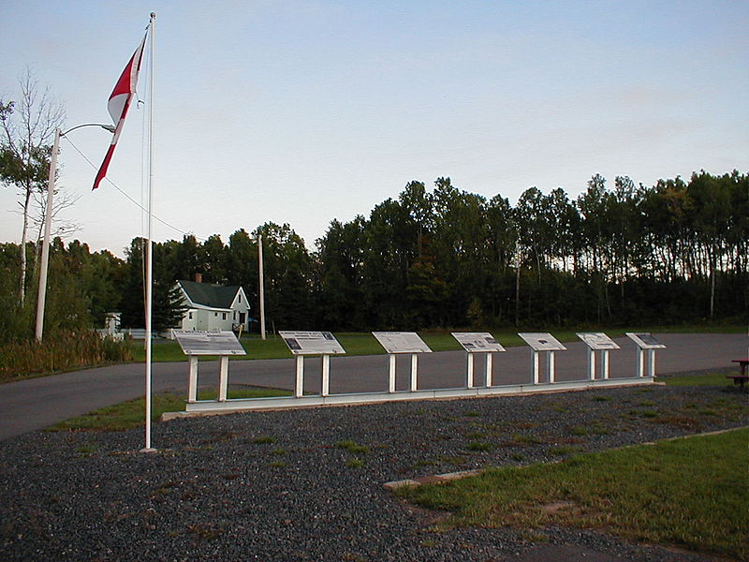
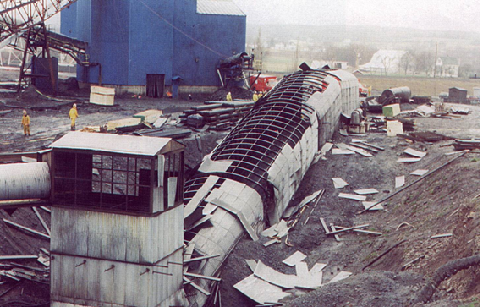
Westray Mine, A “Watershed Incident” - What Happened:
Plymouth, Nova Scotia; 9-May-1992)
Methane-triggered coal dust explosion, 26 fatalities
Owned by Curragh Resources Inc.
“The most important thing to come out of a mine is the miner.”
(Frederic Le Play, 1806-1882, French sociologist and inspector general of mines in France)
Westray Coal Mine (Nova Scotia)
Source: The Westray Story
Image: Wikimedia Commons
Chapter 6.5: OH&S Regulatory Framework in Canada
6
Notes:
6

Slide 7
Westray Mine Incident – Immediate Causes:
Substandard Work Practices:
Poor housekeeping with respect to build up of coal dust in mine
No effort to reduce make coal dust inert by adding rock dust
Continuation of mining in spite of inoperable methane detection devices
Storage of fuel and re-fueling of vehicles underground
Inadequate follow up by NS Gov’t inspectors to address regulatory deficiencies
Substandard Conditions:
Inadequate ventilation system design and capability
Thick layers of coal dust with unacceptably high levels of combustible matter
Inadequate system to warn of conditions leading to explosions
(coal dust and methane)
Chapter 6.5: OH&S Regulatory Framework in Canada
7
Notes:
7

Slide 8
Westray Mine Incident – Basic Causes:
Engineering and Design Factors:
Poor regulating control of and maintaining air flow (inadequate technical design)
Job Factors:
Workers not engaged in day to day decision-making, just follow orders (organizational factors)
Unqualified personnel & poor employee training (inadequate training)
Poor compliance to best industry practices and legislated safety requirements (inadequate job procedures)
Personal Factors:
Fear of reprisal on part of workers (perceived mental or psychological stress)
Corporate Culture was at the root of this incident.
Chapter 6.5: OH&S Regulatory Framework in Canada
8
Notes:
8

Slide 9
Westray Mine, A “Watershed Incident” - The Aftermath:
A public inquiry determined that the mine was mismanaged, miners' safety was ignored, and poor oversight by government regulators led to the disaster.
Criminal charges against the company and two mine managers were laid, and went to trial but dropped (stayed) by the Crown in 1998.
The mine was dismantled and permanently sealed in November 1998.
Due to the failure to successfully prosecute the mine’s owners and managers, the Canadian Labour Congress lobbied the federal government to amend the Criminal Code of Canada in order to hold managers, directors, and corporations criminally liable for incidents.
In 2003, Bill C-45 was passed and was enacted as law in 2004. The legislation resulted in Criminal Code amendments that allow prosecution of corporations
and their directors in workplace incidents.
The change in corporate culture was driven by legislation!
Chapter 6.5: OH&S Regulatory Framework in Canada
9
Notes:
9

Slide 10
What OH&S Rules & Reg’ns Cover Engineering Practice?
Canada’s Criminal Code
Alberta OH&S Reg & Code
APEGA Engineering Act
Engineering OH&S Responsibilities
Alberta Labour Code
Canada’s Labour Code
Chapter 6.5: OH&S Regulatory Framework in Canada
10
Notes:
10

Slide 11

OH&S Under the Criminal Code of Canada:
Criminal Code of Canada R.S.C. C-46 is a codified law for most criminal offences and procedures.
As a result of the Westray LI, the Criminal Code now states:
Duty of persons directing work
217.1 Every one who undertakes, or has the authority, to direct how another person does work or performs a task is under a legal duty to take reasonable steps to prevent bodily harm to that person, or any other person, arising from that work or task. 2003, c. 21, s. 3.
Criminal Negligence
219 (1) Every one is criminally negligent who
(a) in doing anything, or
(b) in omitting to do anything that it is his duty to do,
shows wanton or reckless disregard for the lives or
safety of other persons.
Definition of duty
219 (2) For the purposes of this section, duty means a duty
imposed by law. R.S., c. C-34, s. 202.
Chapter 6.5: OH&S Regulatory Framework in Canada
11
Notes:
11

Slide 12

Engineering & Geoscience Professions Act & Regulation:
Engineering and Geoscience Professions Act of Alberta:
https://open.alberta.ca/publications/e11
Professional engineering - its provincial legislation, self-governing.
APEGA - regulatory agency that ensures compliance with the Act.
Act 2(1): No individual, corporation, partnership or other entity, except a professional engineer … shall engage in the practice of engineering …
Engineering and Geoscience Professions Regulation
https://open.alberta.ca/publications/1999_150
Chapter 6.5: OH&S Regulatory Framework in Canada
12
Notes:
12

Slide 13

OH&S per the Engineering & Geoscience Professions Act AB
Engineering and Geoscience Professions Act of Alberta:
Engineering and Geoscience Professions Regulation
APEGA By-laws! The by-laws specify (describe) how the
requirements of the EGP Act and EGP Regulation are met:
Code of Ethics
Professional Practice Management Plan
Various Guidelines & Professional Practice Standards
https://www.apega.ca/about-apega/publications/engineering-and-geoscience-professions-act/
The Act, Regulations, and APEGA by-laws do not distinguish
between consulting practice and practice within an operating company; these apply to all forms of professional practice.
Chapter 6.5: OH&S Regulatory Framework in Canada
13
Notes:
13

Slide 14
OH&S per the Engineering & Geoscience Professions Act AB
APEGA Code of Ethics (Rules of Conduct):
https://www.apega.ca/members/legal-obligations/
https://www.apega.ca/docs/default-source/pdfs/standards-guidelines/ethical-practice.pdf?sfvrsn=78261e0b_8
Professional engineers and geoscientists shall, in their areas of practice, hold paramount the health, safety and welfare of the public and have regard for the environment.
Professional engineers and geoscientists shall undertake only work that they are competent to perform by virtue of their training and experience.
Professional engineers and geoscientists shall conduct themselves with integrity, honesty, fairness and objectivity in their professional activities.
Professional engineers and geoscientists shall comply with applicable statutes, regulations, and bylaws in their professional practices.
Professional engineers and geoscientists shall uphold and enhance the honour, dignity and reputation of their professions and thus the ability of the professions to serve the public interest.
There may be several pieces of legislation, codes, and regulations that apply to your work.
It is your obligation to remain up to date on this information.
Chapter 6.5: OH&S Regulatory Framework in Canada
14
Notes:
14

Slide 15
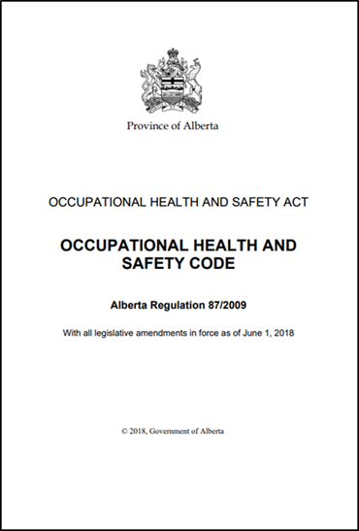
Engineering Under Alberta OH&S Code:
The Professional Engineer and The AB OH&S Code:
Code has 41 parts & 543 pages
200+ references to “engineer” (latest amendments effective June 1, 2018) covering (not comprehensive):
  Cranes, hoists, lifting devices, rigging, ladders
  Electrical (hazardous area) classification
  Fall protection equipment, scaffolding
  Compressed & liquefied gas
  Restraining hoses & piping
  Isolating piping
  Powered mobile equipment
  Elevators
  Ventilation
  Mining, Oil & Gas Wells
  Soil stability, excavations,
  underground shafts, tunnels
Chapter 6.5: OH&S Regulatory Framework in Canada
15
Notes:
15

Slide 16
Example: Engineering Under Alberta OH&S Code, Part 3:
Specific responsibilities for ALL professional engineers:
Part 3 Specifications and Certifications
12 Following specifications:
An employer must ensure that …
(d) equipment and supplies are erected, installed, assembled, started, operated, handled, stored, serviced, tested, adjusted, calibrated, maintained, repaired and dismantled in accordance with the manufacturer’s specifications or the specifications certified by a professional engineer.
13(1) Manufacturer’s and professional engineer’s specifications:
If this Code requires anything to be done in accordance with a manufacturer’s specifications, an employer may, instead of complying strictly with the manufacturer’s specifications, comply with modified specifications certified by a professional engineer.
Chapter 6.5: OH&S Regulatory Framework in Canada
16
Notes:
16

Slide 17
AB OH&S Code Part 3 Spec’ns & Cert’ns, Part 12 Following Specifications:
Province Investigates and Prosecutes under Part 12:
Global News, 3-Aug-2017; 21-year-old dead in apparent workplace injury in Drayton Valley; “A spokesperson with Alberta Occupational Health and Safety (OHS) confirmed it was investigating the death. According to OHS, the man was injured while operating a “ride-on lawnmower” before he was airlifted to the University of Alberta Hospital in Edmonton where he was pronounced dead.”
https://globalnews.ca/news/3647630/21-year-old-dead-in-apparent-workplace-injury-in-drayton-valley-source/
Global News, 23-Dec-2019; Town of Drayton Valley fined $325K in 2017 workplace death; “The town proceeded to plead guilty to one charge of failing to ensure the equipment, a John Deere riding lawn mower, was operated in accordance with the manufacturer’s specifications (or with the specifications of a professional engineer), ….”
ttps://globalnews.ca/news/6330995/drayton-valley-fined-2017-lawnmower-workplace-fatality/
Chapter 6.5: OH&S Regulatory Framework in Canada
17
Notes:
17

Slide 18
ALE #1: Engineering Under Alberta OH&S Code:
Please confer to complete the sentence, and respond (MM Poll)!
Global News, 23-Dec-2019; Town of Drayton Valley fined $325K in 2017 workplace death; “The town proceeded to plead guilty to one charge of failing to ensure the equipment, a John Deere riding lawn mower, was operated in accordance with the manufacturer’s specifications (or with the specifications of a professional engineer), which state the ______
_______________________________________________________.”
Part 3 Specifications and Certifications
12 Following specifications:
An employer must ensure that
(a) …
(b) …
(c) …
(d) equipment and supplies are erected, installed, assembled, started, operated, handled, stored, serviced, tested, adjusted, calibrated, maintained, repaired and dismantled in accordance with the manufacturer’s specifications or the specifications certified by a professional engineer.
Chapter 6.5: OH&S Regulatory Framework in Canada
18
Notes:
18

Slide 19
Example: Engineering Under Alberta OH&S Code:
The incident is not trivial, neither for the family of the deceased person nor the application and enforcement of the AB OH&S Code.
Global News, 23-Dec-2019; Town of Drayton Valley fined $325K in 2017 workplace death; “The town proceeded to plead guilty to one charge of failing to ensure the equipment, a John Deere riding lawn mower, was operated in accordance with the manufacturer’s specifications (or with the specifications of a professional engineer), which state the equipment not be used near ditches, drop-offs, embankments or bodies of water.”
Part 3 Specifications and Certifications
12 Following specifications:
An employer must ensure that
(a) …
(b) …
(c) …
(d) equipment and supplies are erected, installed, assembled, started, operated, handled, stored, serviced, tested, adjusted, calibrated, maintained, repaired and dismantled in accordance with the manufacturer’s specifications or the specifications certified by a professional engineer.
Chapter 6.5: OH&S Regulatory Framework in Canada
19
Notes:
19

Slide 20
ALE #2: Cultural Issues and the RM Elements:
Typical cultural issues, as found by OH&S Investigations that are behind workplace injuries. Please confer and match the workplace attitudes (cultural issues) to the RMEs (open discussion):
Inadequate training/competency (a common
theme for incidents during an economic boom).
Failure to stop and re-assess when the scope
of work changes or the conditions on the job
change.
“I was only going to be up there for a minute.”
Failure to learn lessons after “near misses”.
Failure to recognize and act on signals before
the incident happens.
RM Elements
MLC&A
RA&MR
CA&EP
MOC
IRIA&A
PE&CI
DC&SU
O&M
EC&T
CC&I
O&F I&D
Chapter 6.5: OH&S Regulatory Framework in Canada
20

Slide 21
Example: Workplace Attitudes and RM Elements:
Typical workplace attitudes (cultural issues) and relevance to RMEs:
Inadequate training/competency
  9) Employee Competency and Training
Failure to stop and re-assess when the scope / conditions changes
  4) Management of Change
“I was only going to be up there for a minute”
  1) Management Leadership, Commitment, and Accountability
  2) Risk Assessment and Management of Risk
Failure to learn lessons after “near misses”
  5) Incident Reporting, Investigation, Analysis and Action
Failure to recognize and act on signals before the incident happens
  1) Management Leadership, Commitment, and Accountability
  2) Risk Assessment and Management of Risk
Chapter 6.5: OH&S Regulatory Framework in Canada
21

Slide 22

Summary:
The Westray tragedy led to changes in the Canadian Criminal Code to include OH&S related offences.
Engineers are responsible for adhering to OH&S requirements from a number of professional and governmental bodies:
  EGP Act
  EGP Regulation
  APEGA By-laws
  OH&S Code: Specific example of the
  responsibility that universally applies to any
  professional engineer pertains to AB OH&S
  Code Part 3 Specifications and Certifications,
  Section 12 Following Specifications.
Engineers and their employers can be held
liable for incidents if they do not adhere to
requirements; penalties can be severe.
Chapter 6.5: OH&S Regulatory Framework in Canada
22
Notes:
22

Slide 23
Any questions?
Notes:
23

